Slide 1



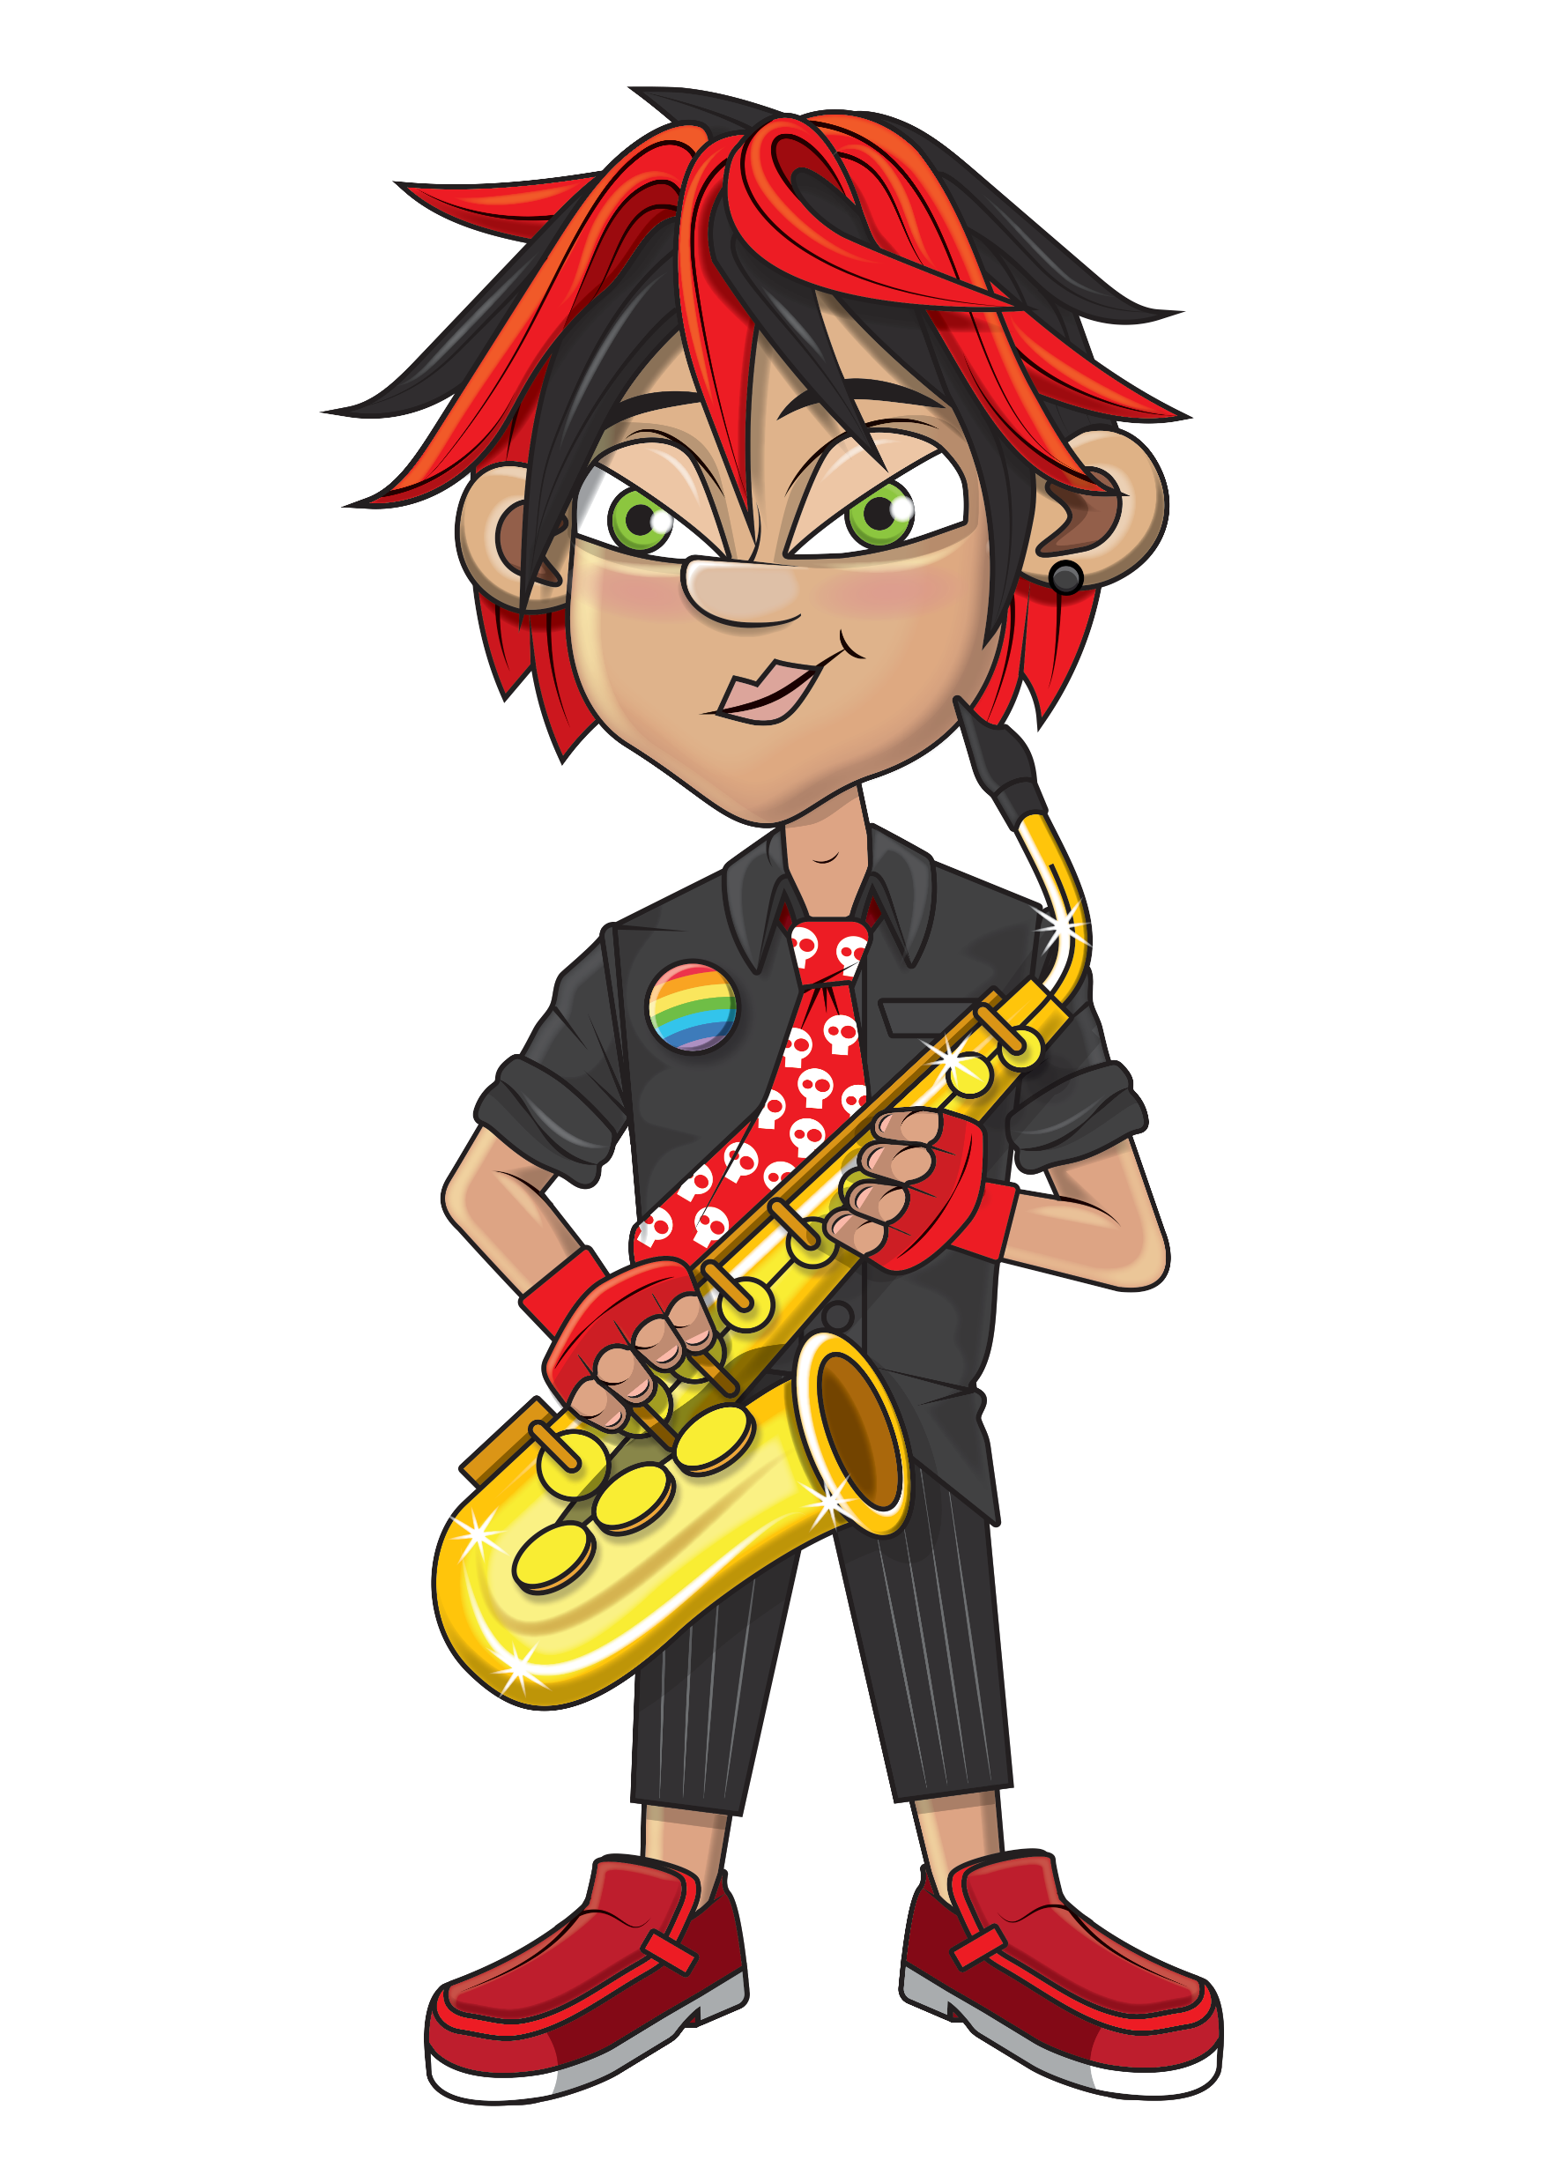


Slide 2
Warm-up
9, 18, 27, 36, 45,
54, 63, 72, 81,
90, 99, 108.

Slide 3
Let’s rock and roll the 9s!

Slide 4
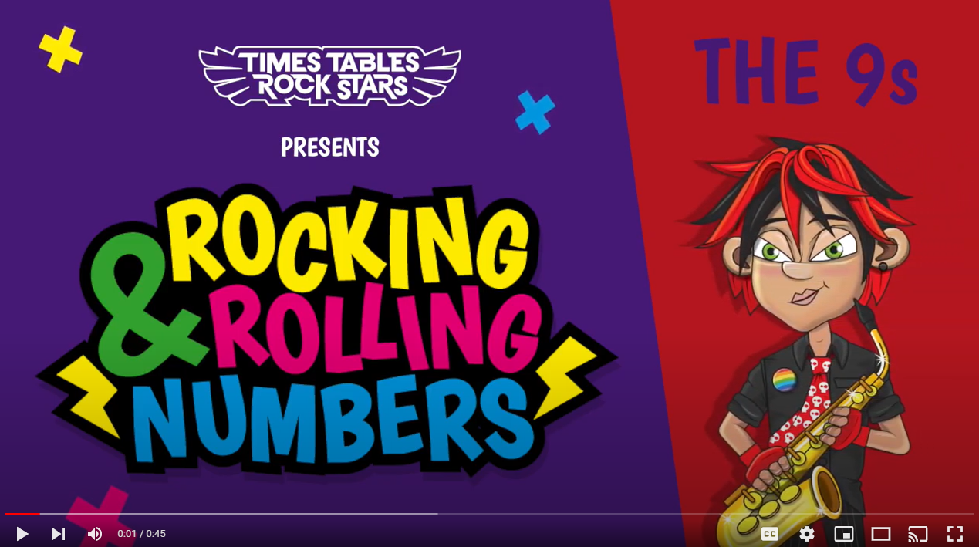
Continue with the lyrics in PowerPoint.
or
Play video

Slide 5
(The next 2 slides are the intro that you use for all tables in the ‘Rocking and Rolling Numbers’ series.)

Slide 6


Intro
Are you ready?
Ready for what?
Are you ready?
We’re ready to rock!

Slide 7

Intro
How do you want to rock today?
We’re ready to rock in a 9s kind of way!
Wooooooooooooaaaaaaaaaaaaahhhhhhh!!!
Notes:
Note that in the class’ line “We’re ready to rock in a ___ kind of way!” you’ll need to change that number to whichever table you’re rocking and rolling today.

Slide 8
(And now we get into the lyrics for this particular table.)

Slide 9
The 9s
9, 18 and 27.

Slide 10
The 9s
36 and 45.

Slide 11
The 9s
54 and 63.

Slide 12
The 9s
72 and 81.

Slide 13
The 9s
90!
99, 108.

Slide 14
The 9s
Rock with us,
we’re doing great!

Slide 15
(You’ve got to the end!)

Slide 16
(On the next slide, you’ve got all the lyrics in one place in case you’d prefer to see it all together.)

Slide 17
Intro
The 9s
Are you ready?
Ready for what?
Are you ready?
We’re ready to rock!
How do you want to rock today?
We’re ready to rock in a 9s kind of way!
Woooooooooaaaaaaahhh!
9, 18 and 27.
36 and 45.
54 and 63.
72 and 81.
90!
99, 108.
Rock with us,
we’re doing great!

