Slide 1



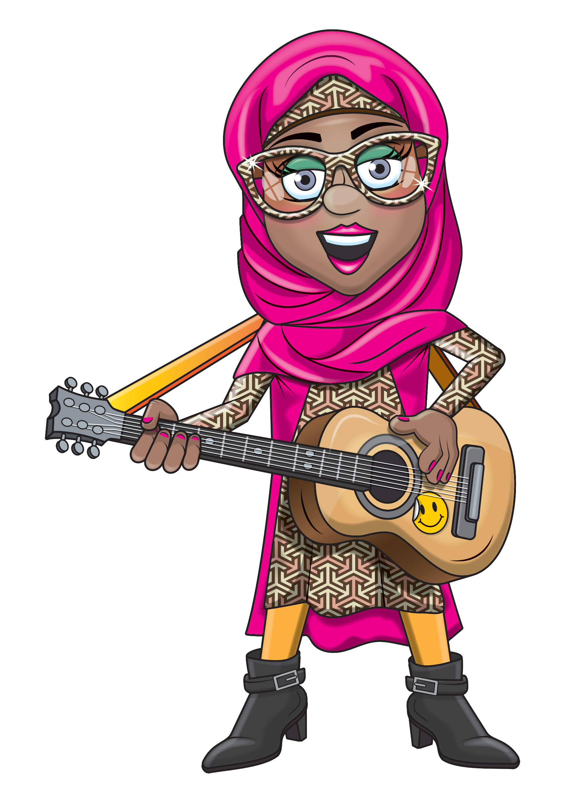
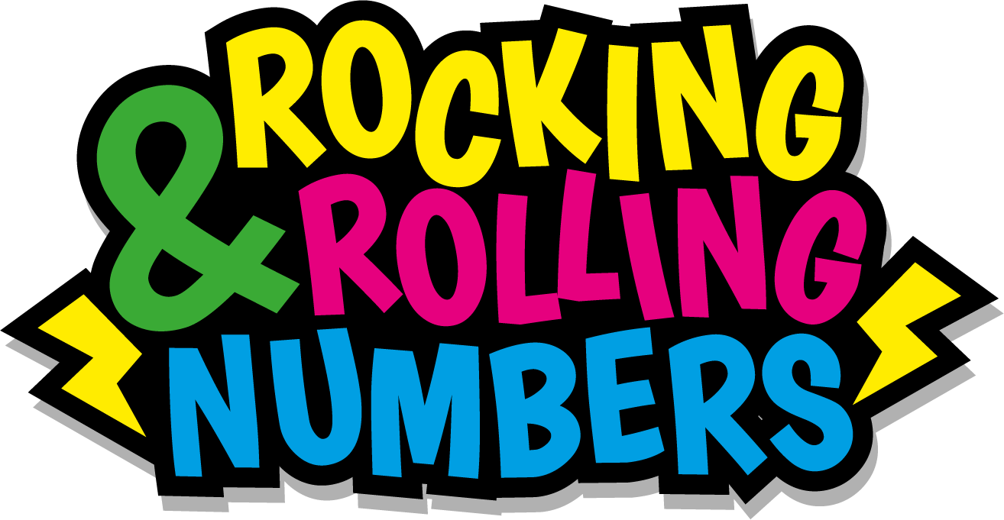

Slide 2
Warm-up
6, 12, 18, 24, 30,
36, 42, 48, 54, 60,
66, 72

Slide 3
Let’s rock and roll the 6s!

Slide 4
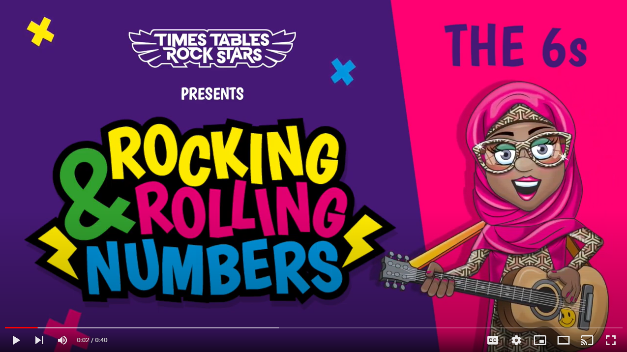
Continue with the lyrics in PowerPoint.
or
Play video

Slide 5
(The next 2 slides are the intro that you use for all tables in the ‘Rocking and Rolling Numbers’ series.)

Slide 6


Intro
Are you ready?
Ready for what?
Are you ready?
We’re ready to rock!

Slide 7

Intro
How do you want to rock today?
We’re ready to rock in a 6s kind of way!
Wooooooooooooaaaaaaaaaaaaahhhhhhh!!!
Notes:
Note that in the class’ line “We’re ready to rock in a ___ kind of way!” you’ll need to change that number to whichever table you’re rocking and rolling today.

Slide 8
(And now we get into the lyrics for this particular table.)

Slide 9
The 6s
6, 12.
18, 24.

Slide 10
The 6s
30, 36, 42, 48.

Slide 11
The 6s
54, 60, 66, 72.

Slide 12
The 10s
Rox knows the music.
Clap clap your hands.

Slide 13
The 6s
We know the 6s.

Slide 14
The 6s
Jammin’ with our band.

Slide 15
(You’ve got to the end!)

Slide 16
(On the next slide, you’ve got all the lyrics in one place in case you’d prefer to see it all together.)

Slide 17
Intro
The 6s
Are you ready?
Ready for what?
Are you ready?
We’re ready to rock!
How do you want to rock today?
We’re ready to rock in a 6s kind of way!
Woooooooooaaaaaaahhh!
6, 12.
18, 24.
30, 36, 42, 48.
54, 60, 66, 72.
Rox knows the music.
Clap clap your hands.
We know the 6s.
Jammin’ with our band!

