Slide 1
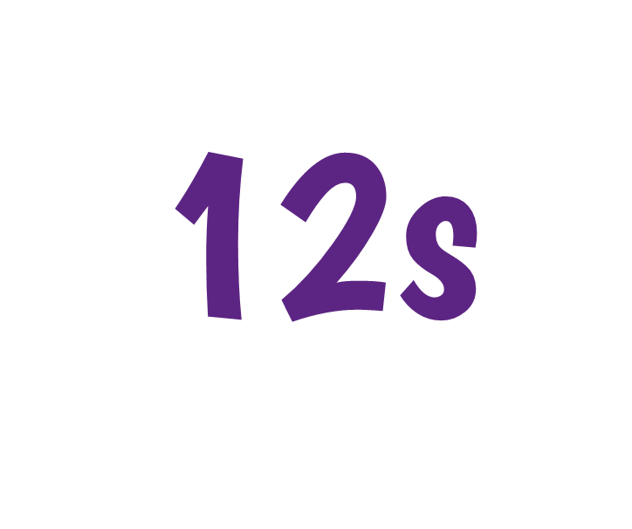

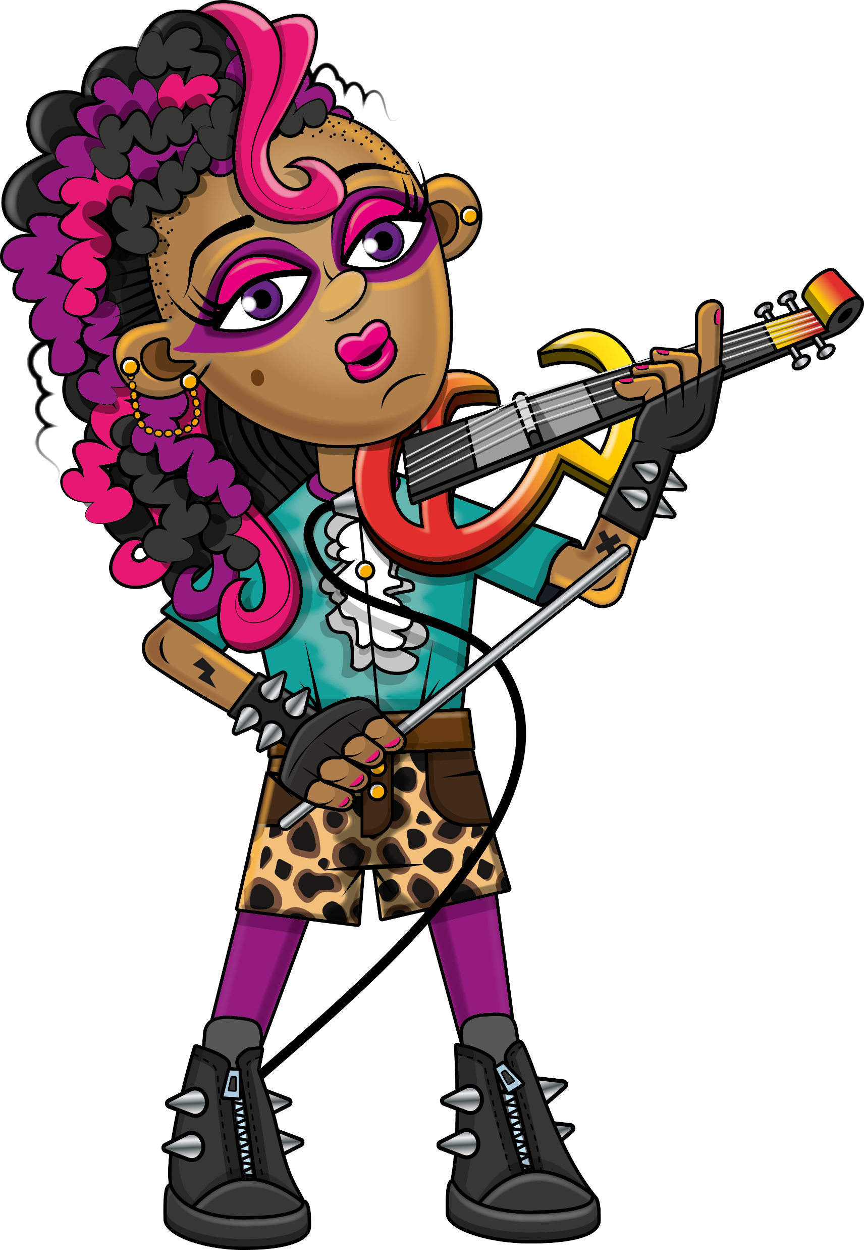

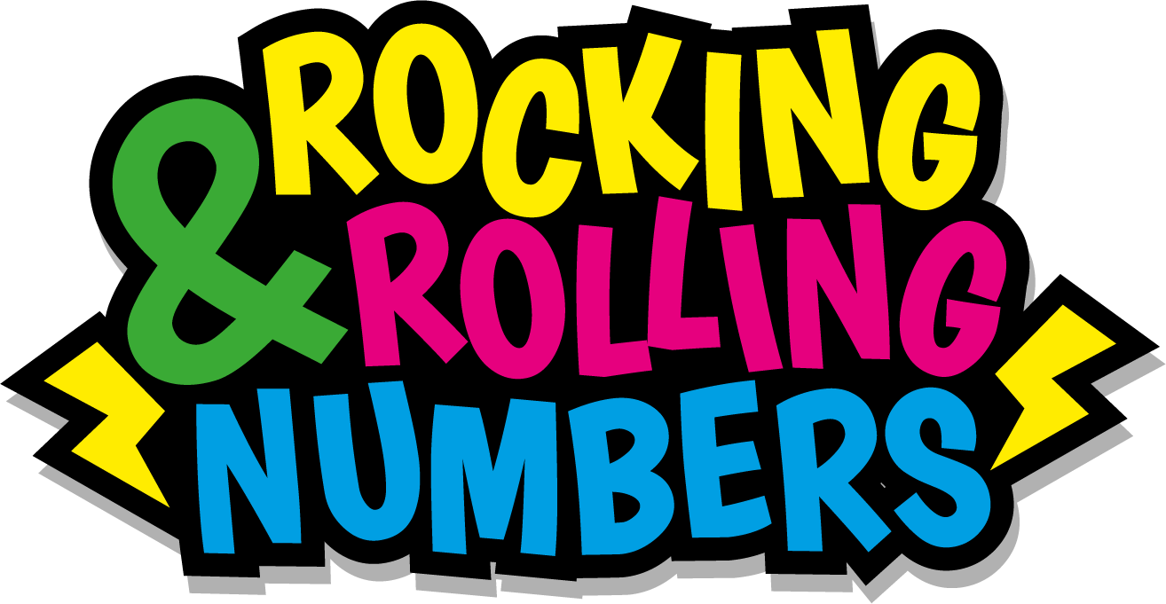

Slide 2
Warm-up
12, 24, 36, 48, 60,
72, 84, 96, 108, 120,
132, 144.

Slide 3
Let’s rock and roll the 12s!

Slide 4
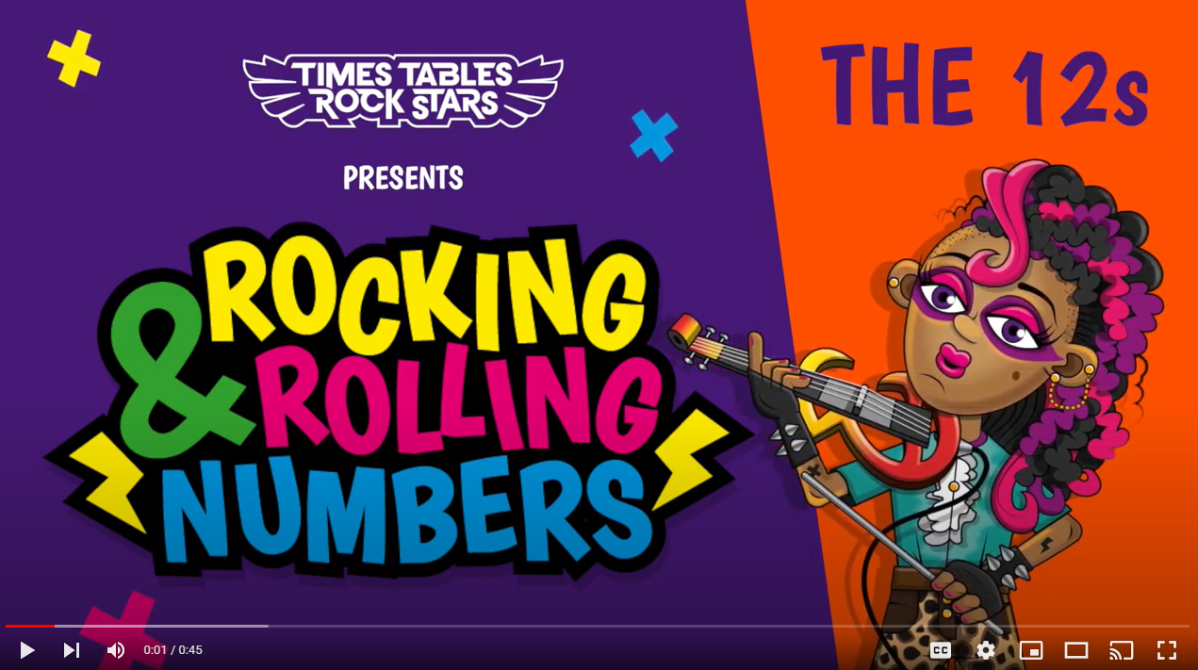
Continue with the lyrics in PowerPoint.
or
Play video

Slide 5
(The next 2 slides are the intro that you use for all tables in the ‘Rocking and Rolling Numbers’ series.)

Slide 6


Intro
Are you ready?
Ready for what?
Are you ready?
We’re ready to rock!

Slide 7

Intro
How do you want to rock today?
We’re ready to rock in a 12s kind of way!
Wooooooooooooaaaaaaaaaaaaahhhhhhh!!!
Notes:
Note that in the class’ line “We’re ready to rock in a ___ kind of way!” you’ll need to change that number to whichever table you’re rocking and rolling today.

Slide 8
(And now we get into the lyrics for this particular table.)

Slide 9
The 12s
12, 24, 36, 48.

Slide 10
The 12s
Electra’s on the dance floor.
Throwing some shapes!

Slide 11
The 12s
60, 72, 84, 96.

Slide 12
The 12s
These are the 12s.
Lickety splitz!

Slide 13
The 12s
108, 120.
We’re nearly there.

Slide 14
The 12s
Give it plenty!

Slide 15
The 12s
132, 144…

Slide 16
The 12s
Whoomph, there it is.
Whoomph some more.

Slide 17
(You’ve got to the end!)

Slide 18
(On the next slide, you’ve got all the lyrics in one place in case you’d prefer to see it all together.)

Slide 19
Intro
The 12s
12, 24, 36, 48.
Electra’s on the dance floor.
Throwing some shapes.
60, 72, 84, 96.
These are the 12s, lickety
splitz.
108, 120.
We’re nearly there.
Give it plenty!
132, 144.
Whomph there it is.
Whomph some more.
Are you ready?
Ready for what?
Are you ready?
We’re ready to rock!
How do you want to rock today?
We’re ready to rock in a 12s kind of way!
Woooooooooaaaaaaahhh!

