Slide 1
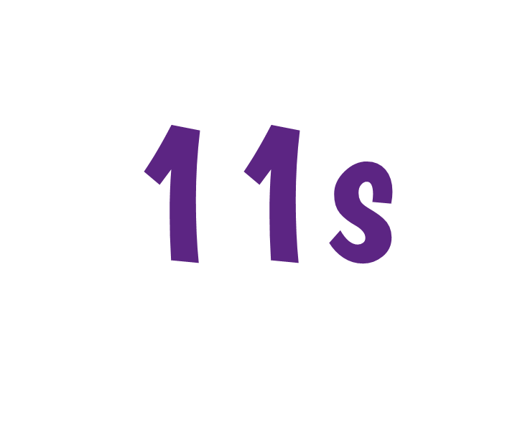


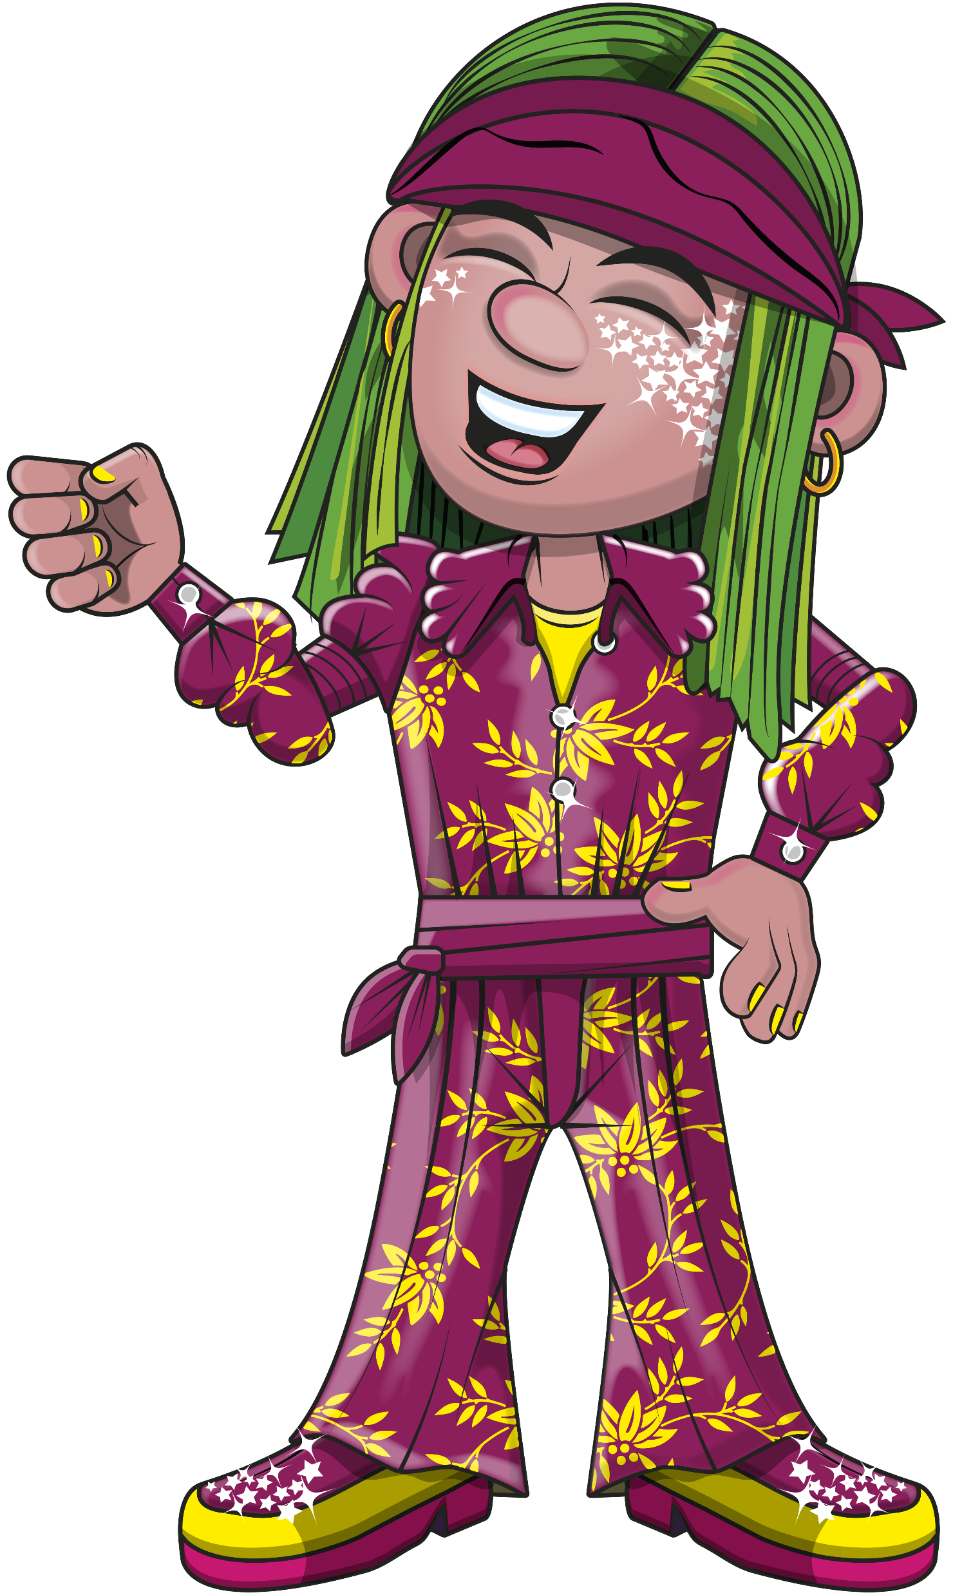
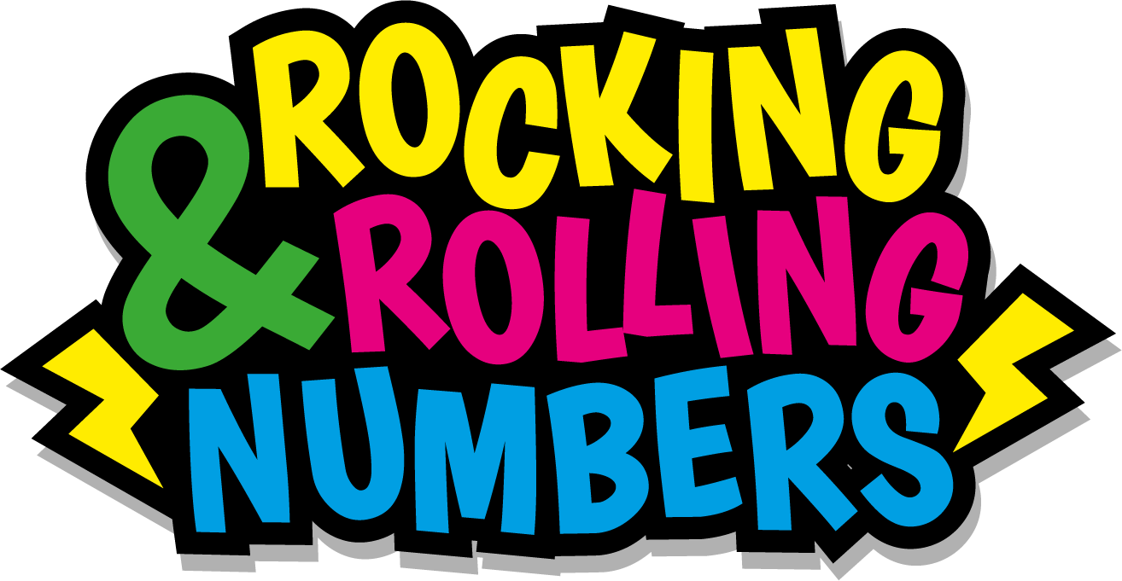

Slide 2
Warm-up
11, 22, 33, 44, 55,
66, 77, 88, 99, 110,
121, 132.

Slide 3
Let’s rock and roll the 11s!

Slide 4
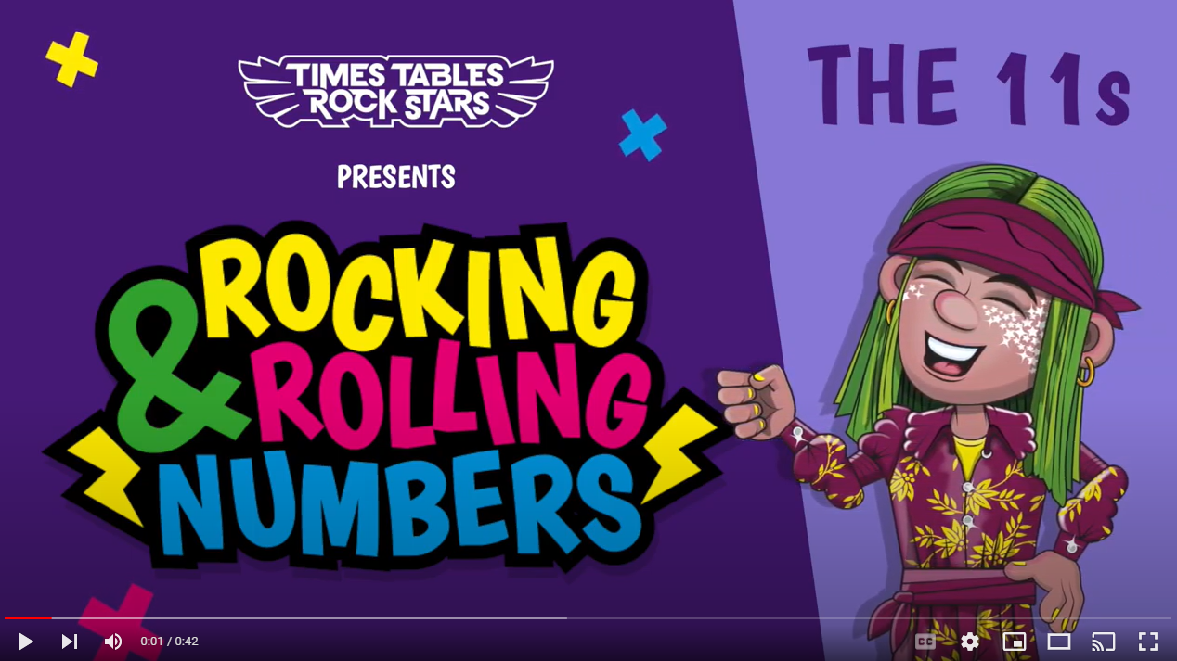
Continue with the lyrics in PowerPoint.
or
Play video

Slide 5
(The next 2 slides are the intro that you use for all tables in the ‘Rocking and Rolling Numbers’ series.)

Slide 6


Intro
Are you ready?
Ready for what?
Are you ready?
We’re ready to rock!

Slide 7

Intro
How do you want to rock today?
We’re ready to rock in an 11s kind of way!
Wooooooooooooaaaaaaaaaaaaahhhhhhh!!!
Notes:
Note that in the class’ line “We’re ready to rock in a ___ kind of way!” you’ll need to change that number to whichever table you’re rocking and rolling today.

Slide 8
(And now we get into the lyrics for this particular table.)

Slide 9
The 11s
11, 22, 33, 44.

Slide 10
The 11s
55, 66.
77 to the floor.

Slide 11
The11s
88, 99, 110.

Slide 12
The 11s
We’re not there yet.
You’ll know when…

Slide 13
The11s
121, 132.

Slide 14
The 11s
Now we’re at the top.
Look at that view…

Slide 15
(You’ve got to the end!)

Slide 16
(On the next slide, you’ve got all the lyrics in one place in case you’d prefer to see it all together.)

Slide 17
Intro
The 11s
Are you ready?
Ready for what?
Are you ready?
We’re ready to rock!
How do you want to rock today?
We’re ready to rock in a 11s kind of way!
Woooooooooaaaaaaahhh!
11, 22, 33, 44.
55, 66, 77.
To the floor.
88, 99, 110.
We’re not there yet.
You’ll know when.
121, 132.
Now we’re at the top.
Look at that view!

