Slide 1



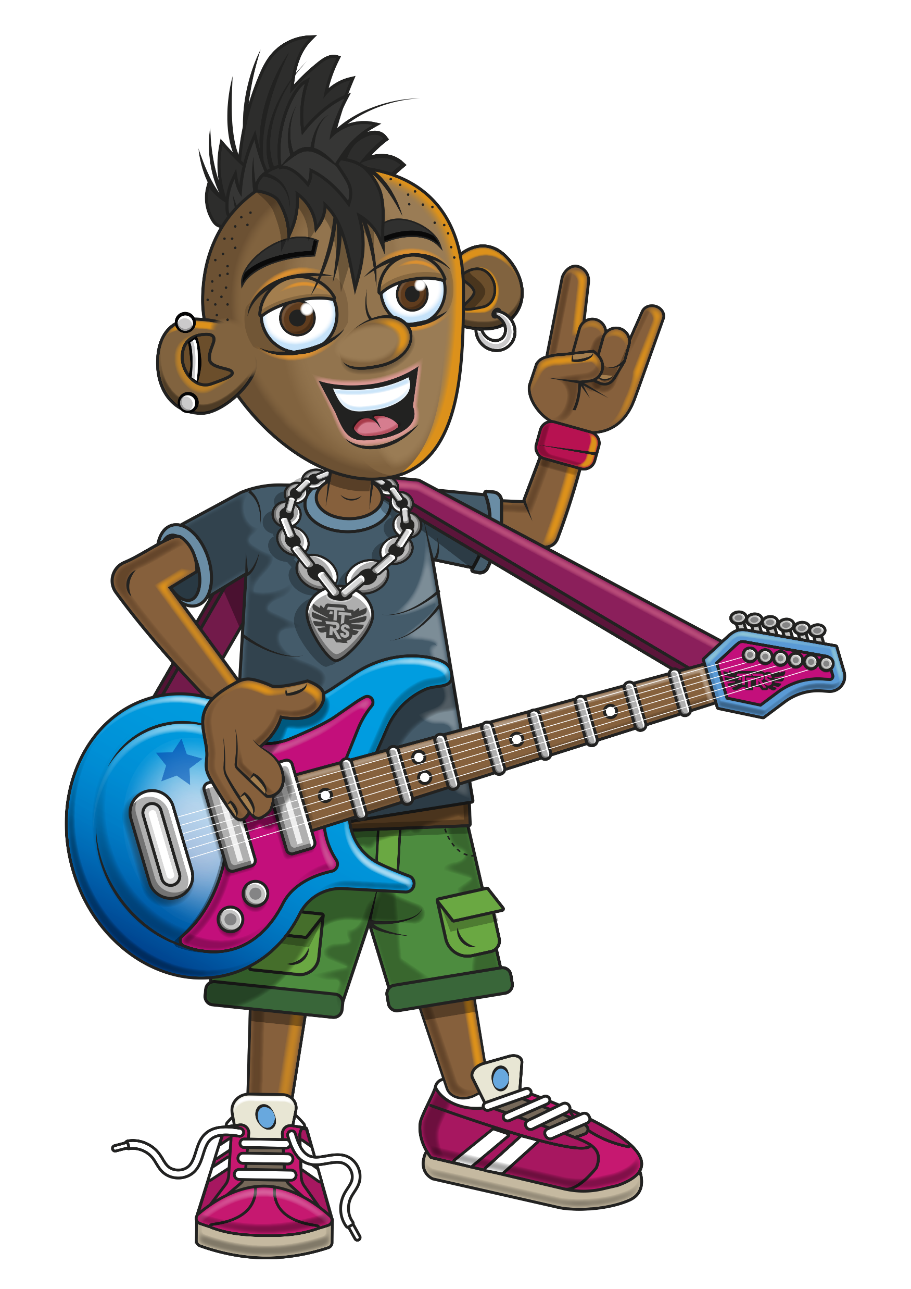

PRESENTS
THE 10s

Slide 2
Warm-up
10, 20, 30, 40, 50, 60,
70, 80, 90, 100, 110, 120
Notes:
Get the class to skip count forwards.
Then in reverse (follow the yellow arrow and count down).
Then finally, get them to count in either direction once some of the numbers have been hidden.

Slide 3
Let’s rock and roll the 10s!

Slide 4
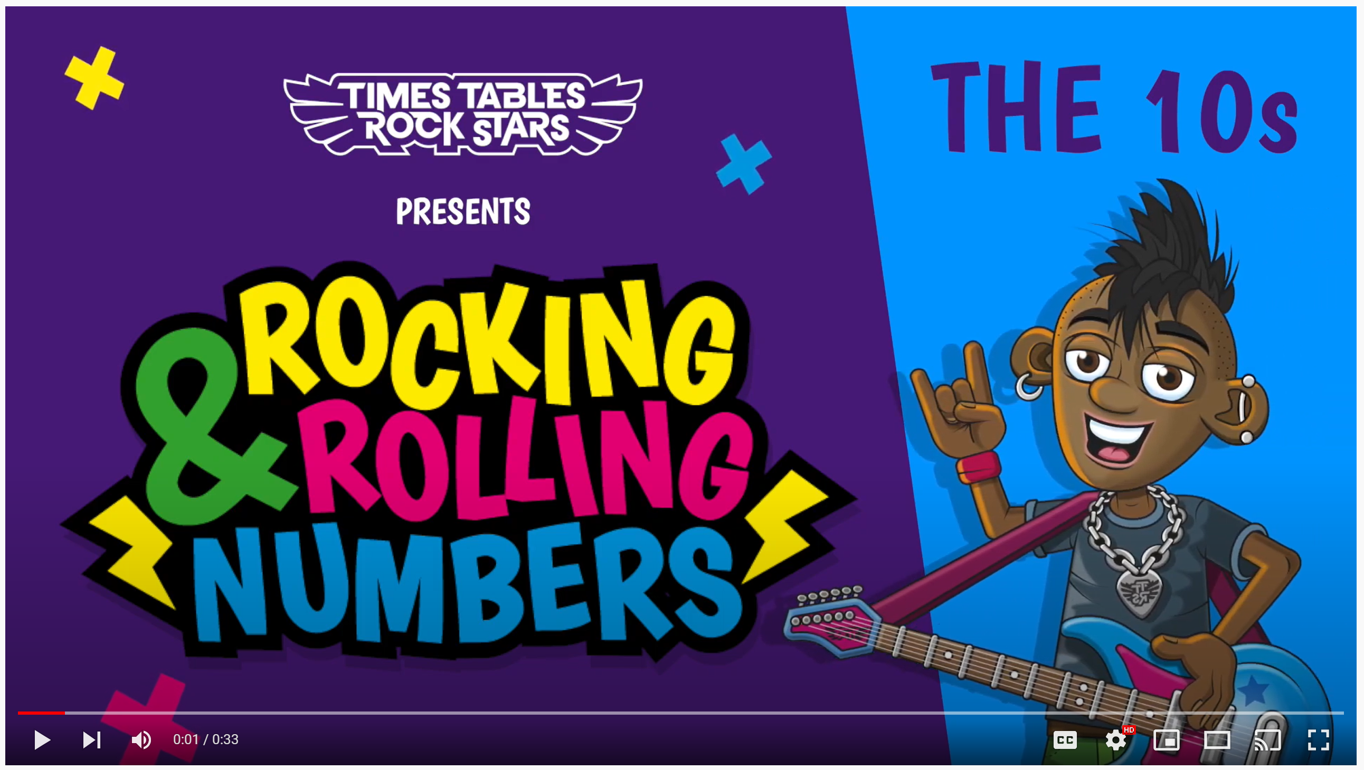
Continue with the lyrics in PowerPoint.
or
Play video

Slide 5
(The next 2 slides are the intro that you use for all tables in the ‘Rocking and Rolling Numbers’ series).

Slide 6


Intro
Are you ready?
Ready for what?
Are you ready?
We’re ready to rock!

Slide 7

Intro
How do you want to rock today?
We’re ready to rock in a 10s kind of way!
Wooooooooooooaaaaaaaaaaaaahhhhhhh!!!
Notes:
Note that in the class’ line “We’re ready to rock in a ___ kind of way!” you’ll need to change that number to whichever table you’re rocking and rolling today.

Slide 8
(And now we get into the lyrics for this particular table).

Slide 9

The 10s
10
20
30, 40, 50

Slide 10
The 10s
60
70
80, 90, 100

Slide 11
The 10s
Dazzle’s on rhythm.
He’s got the melody.
110
120!

Slide 12
(You’ve got to the end!)

Slide 13
On the next slide, you’ve got all the lyrics in one place in case you’d prefer to see it all together.

Slide 14
Intro
The 10s
Are you ready?
Ready for what?
Are you ready?
We’re ready to rock!
How do you want to rock today?
We’re ready to rock in a 10s kind of way!
Woooooooooaaaaaaahhh!
10
20
30, 40, 50
60
70
80, 90, 100
Dazzle’s on rhythm.
He’s got the melody.
110
120!

